Slide 1
Hello! Congratulations on creating your first business idea. It is now time for you to create your business model so you can pitch your amazing idea to the class.
The following business model is a sample for you to review. You don’t need to follow the design or number of slides that are used in this sample, however, you should follow the order that information is presented. Feel free to include additional content if you believe it will help the audience better understand your business idea.
Good luck,
Dwight the Light Bulb

Slide 2
Launch Group
Introduction Slide
Introduce yourself and the name of your business. You can include your business name and logo on this slide.

Slide 3
Story Slide
You want to tell a story that builds up to your business idea. Dwight’s story can be about how he has been going to networking events the past year in Orange County, CA. At each networking event, he usually meets a young entrepreneur who is struggling with their startup. Dwight has always given advice to these young entrepreneurs and made sure to follow up them each month to track their progress.
You only need to include a picture on this slide for people to view while you are telling your story.

Slide 4
1,100
Optional Slide
If your business idea affects many people, you can use this slide with your story to highlight the large number.
For example, Dwight could use this slide to reinforce how there are many young entrepreneurs who need mentorship since 1,100 startups are created each month in his city.
New Startups Created Each Month!

Slide 5
Startup Mentoring
Idea Slide
This is when you want to present your AMAZING business idea. Be enthusiastic when you unveil your grand idea to your audience. Dwight could transition to this slide by saying as his support group began to grow, he realized he had found a business opportunity to mentor young entrepreneurs.
My business idea is...

Slide 6
Business
Description
Industry
Mentorship
Product/Service
Service
Values
In-Person, Flexibility
Launch Group - Startup Mentoring
Explain your business idea in more detail with bullet points.
We provide in-peron mentoring for any situation related to your startup.
We provide flexibility by allowing people to choose the time and location of their appointment.
Our schedule is Monday through Saturday from 7:00am to 5:00pm (excluding major holidays).
Appointments can be booked with a 24 hour notice.
Refunds are available if you call 1 hour before your appointment
Description Slide
This slide is used to display your industry, product/service, and value. You will also use this slide to go into further detail of your business idea. Use bullet points for additional information but limit to six or less.

Slide 7
Prototype Slide
This is when you want to show and explain the prototype of your product. If you have a service, try to include pictures of you providing your service or find a related picture on the web to provide a visual of your service to the audience.

Slide 8
Target Market
Target Market
Age Group: Teenagers; Young Adults; Adults
Location: Orange County, California
Interests: Entrepreneurship; Technology; Innovation; Stock Market
Lifestyle: Ambitious individuals who have a busy schedule which revolves around activities/tasks for their business. They take limited vacation time and frequently attend networking events.
Target Market Slide
This slide is used to display your target market information.

Slide 9
Optional Slide
It helps to use a world map if your target market is global.

Slide 10
Marketing
Marketing
Direct messaging and paid advertisements on social media platforms.
Attend Meetup entrepreneurship events and hand out business cards.
Marketing Slide
This slide is used to display your marketing strategy.

Slide 11
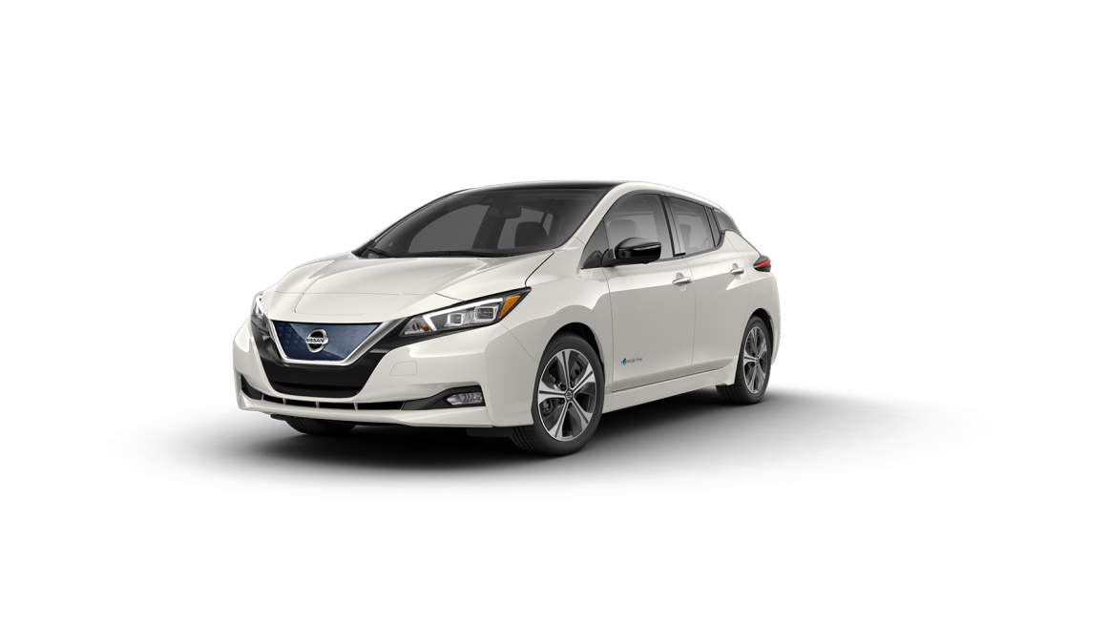
Costs
Costs
13 inch MacBook Pro - $1,299.00
iPhone Xr - $449.00
T-Mobile ONE plan - $70.00/month
Nissan Leaf lease - $425.00/month
Car Insurance - $99.00/month
Electric car charge - $40.00/month
Office related supplies (ex. notebook) - $15.00/month
Business cards - $9.99
Social media advertising - $100.00/month
Costs Slide.
This slide is used to display your business’s costs.

Slide 12
Pricing Strategy
Receive $100.00
if you refer a friend
and they sign up.
Pricing
$200.00 for 2 / 1 hr mentoring sessions a month.
$350.00 for 4 / 1 hr mentoring sessions a month
$400.00 for 6 / 1 hr mentoring sessions a month.
Pricing Slide
This slide is used to display your pricing strategy.

Slide 13
Thank you!
Any questions?
You can find me on instagram @kid_entrepreneurship & email me at info@kidentrepreneurship.com
Closing Slide
This slide is used to display your contact information so your audience can reach you if they have more questions.

